Slide 1
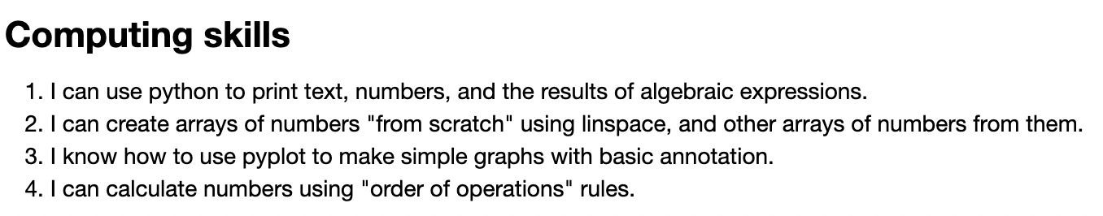
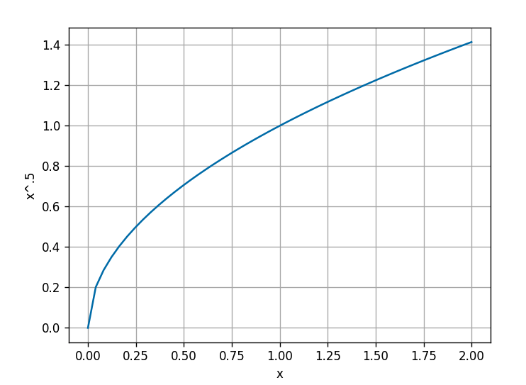
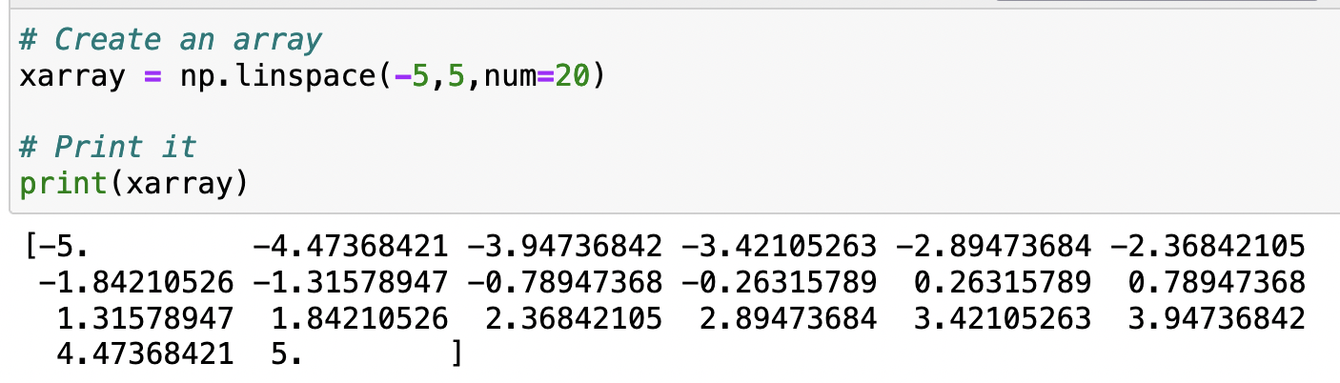
Recap of main points this week
From the Arrays CGI …

Slide 2
The kind of thing I might ask you during our interview (Week 7)
Say we have this code:
xarray = np.linspace(0,2,100)
What will be the result of this print statement?
print(xarray)

Slide 3
The kind of thing I might ask you during our interview (Week 7)
If we say this:
xarray = np.linspace(0,2,100)
rootx = xarray**(1/2)
Then, which of the following will produce the graph shown at right?
plt.plot(xarray,rootx)
or
plt.plot(rootx, xarray)

Slide 4
The kind of thing I might ask you during our interview (Week 7)
If we say this:
a = 3*8**3-10
Which of these will give the same result?
b = (3*8**3)-10
c = 3*(8**3-10)

Slide 5
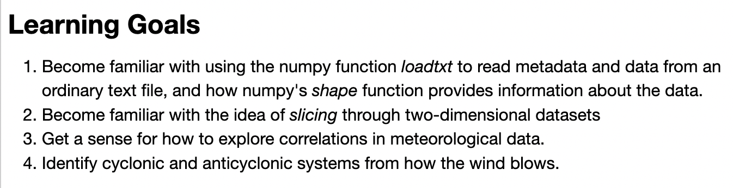
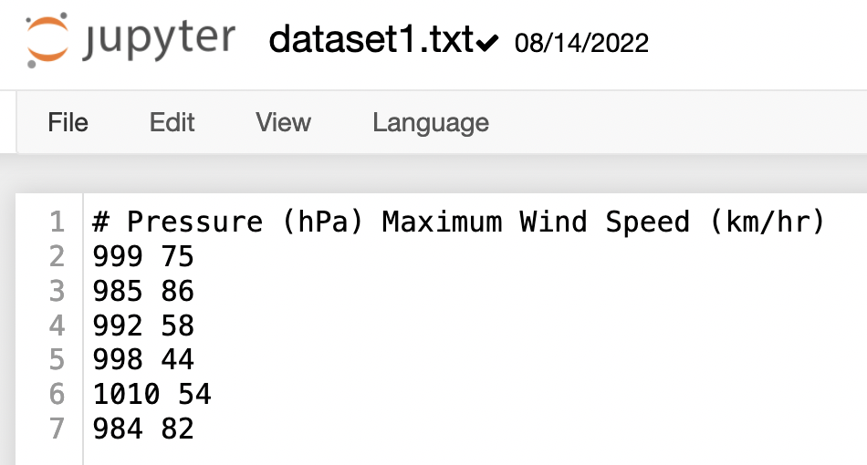
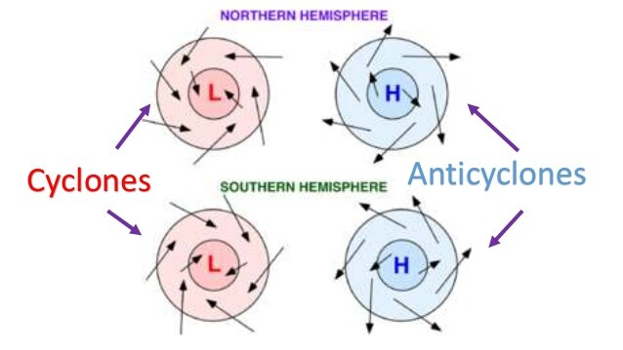
Recap of main points this week
From the SynopticSystems CGI …

Slide 6
The kind of thing I might ask you during our interview (Week 7)
If we say this:
# Load the data
filename = 'dataset1.txt'
data = np.loadtxt(filename)
What will appear when we say this:
print(np.shape(data))

Slide 7
The kind of thing I might ask you during our interview (Week 7)
If we say this:
# Load the data
filename = 'dataset1.txt'
data = np.loadtxt(filename)
What will appear when we say this:
print(np.shape(data))
(6, 2)

Slide 8
The kind of thing I might ask you during our interview (Week 7)
If we say this:
# Load the data
filename = 'dataset1.txt'
data = np.loadtxt(filename)
Which will appear when we say this:
print(data[:,1])
[ 999. 985. 992. 998. 1010. 984.]
or
[75. 86. 58. 44. 54. 82.]

Slide 9
The kind of thing I might ask you during our interview (Week 7)
If we say this:
# Load the data
filename = 'dataset1.txt'
data = np.loadtxt(filename)
Which will appear when we say this:
print(data[:,1])
[ 999. 985. 992. 998. 1010. 984.]
or
[75. 86. 58. 44. 54. 82.]

Slide 10
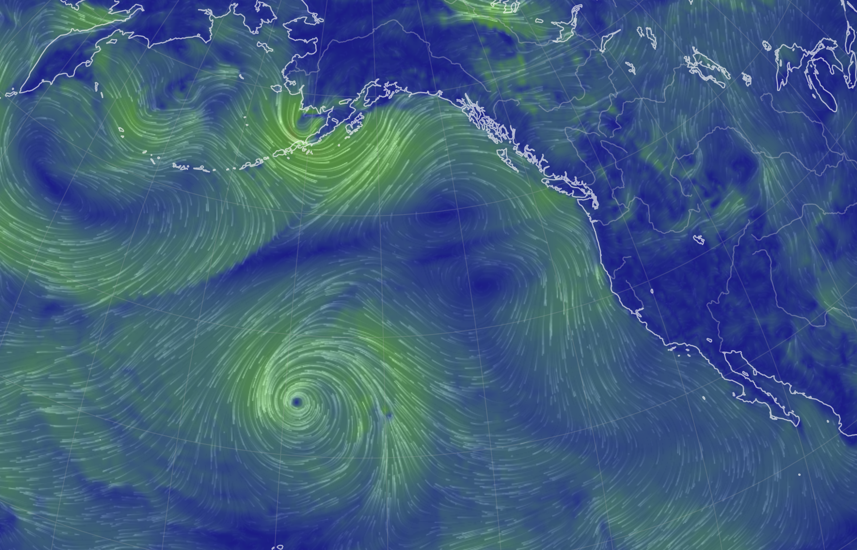
The kind of thing I might ask you during our interview (Week 7)
Is it stormy and rainy here, or clear and dry?
Is this a low-pressure system or a high-pressure system?
Let’s look at some examples in earth.nullschool.net!

Slide 11
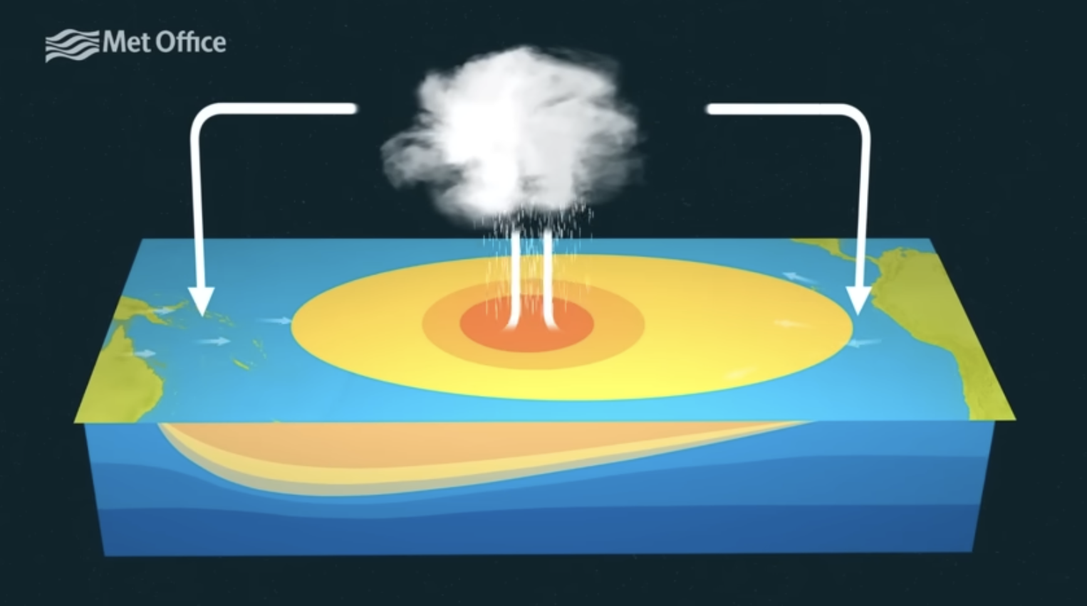
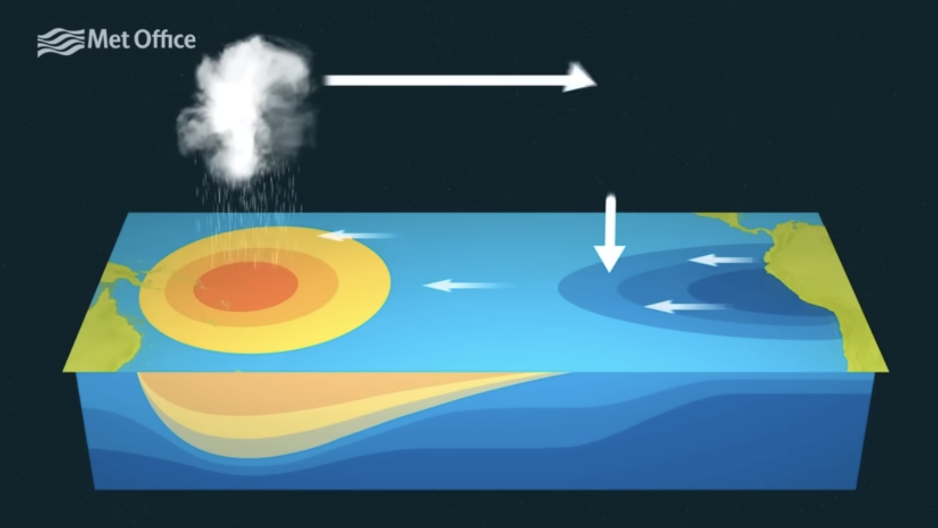
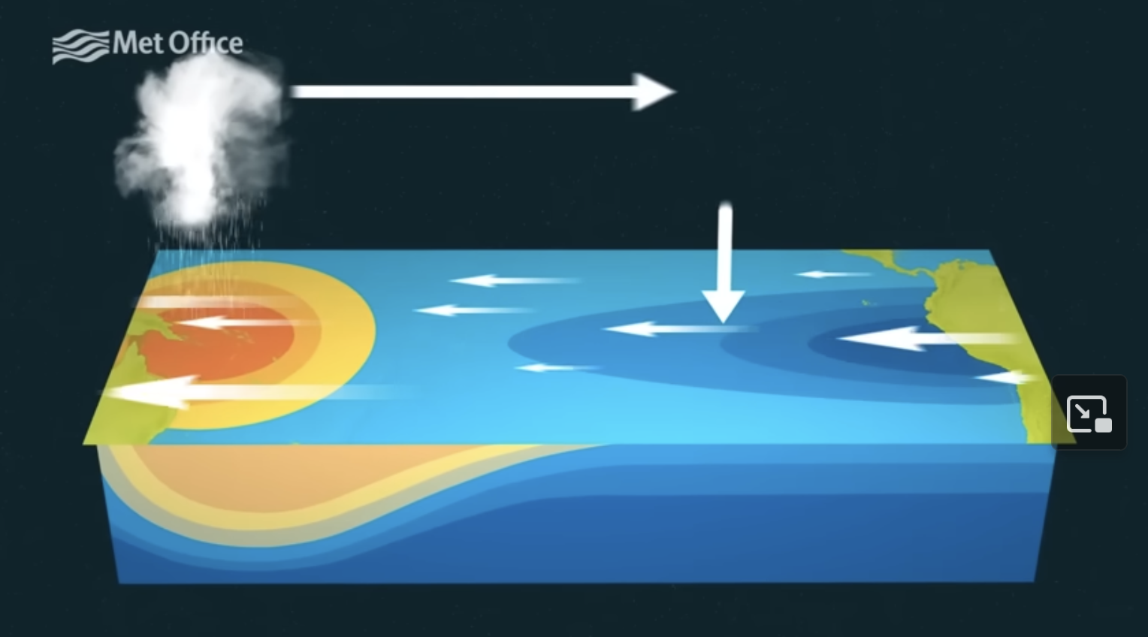
The kind of thing I might ask you during our interview (Week 7)
A
B
Which of these (A, B, or C) is “normal”
C

Slide 12
The kind of thing I might ask you during our interview (Week 7)
A
B
Which of these (A, B, or C) is an El Niño?
C

Slide 13
The kind of thing I might ask you during our interview (Week 7)
A
B
Why is the ocean temperature off the coast of Peru so cold in B and C?
C

Slide 14
The kind of thing I might ask you during our interview (Week 7)
A
B
What’s the name we associate with these arrows?
Rossby waves
Trade winds
Jet stream
C

Slide 15
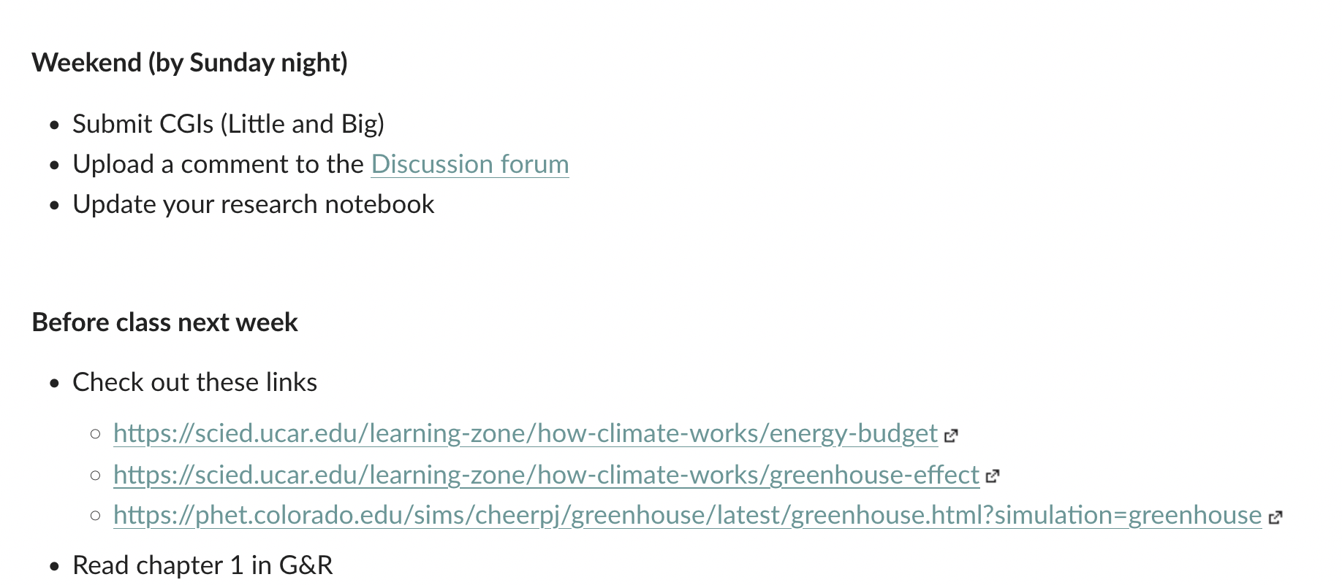
By midnight Saturday

Slide 16
Preparations for next week

Slide 17
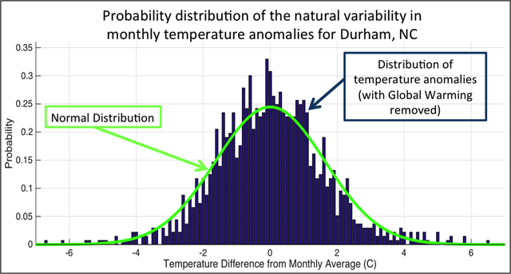
About Chapter 1 of G&R: Climate as a statistical idea
Climate is a distribution of possible possible weather states
Weather is a state in the distribution
Extremes – the sides of the distribution
Modeling consists of knowing the current state and using physics-based equations to project it forward.
Numerical Weather Prediction (NWP) models are sophisticated models used to project into the future (a few days).
Earth.nullschool.net is a reanalysis model – a model that actively incorporates measurements. Also good for a few days into the future.
Global Climate Models (GCMs) project farther into the future. Accuracy is not good past a week or two, but we hope the statistics are reliable.

Slide 18
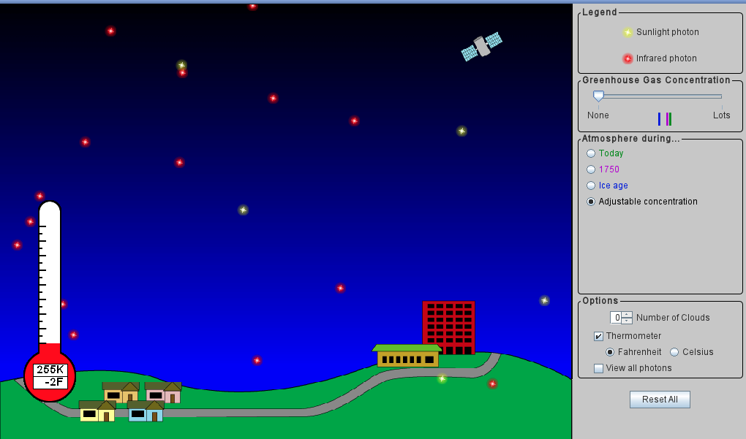
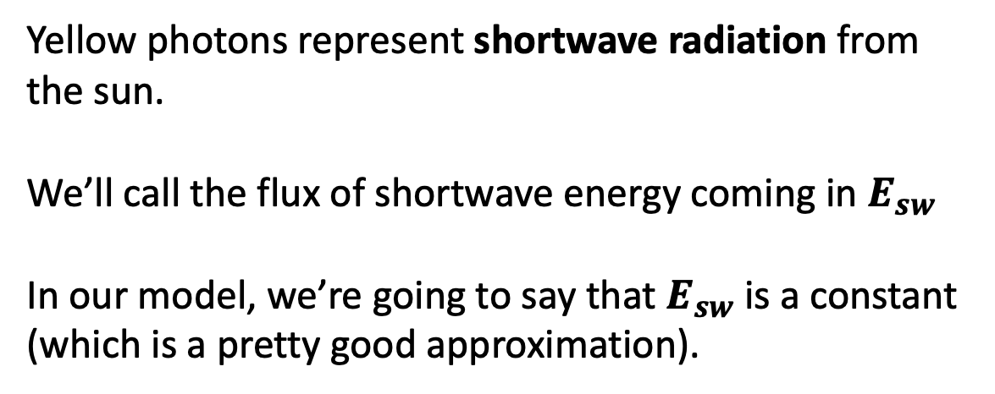
About that PhET simulator: Principle of radiative balance
Yellow photons represent shortwave radiation from the sun.
We’ll call the flux of shortwave energy coming in $E_{sw}$
In our model, we’re going to say that $E_{sw}$ is a constant (which is a pretty good approximation).
https://phet.colorado.edu/sims/cheerpj/greenhouse/latest/greenhouse.html?simulation=greenhouse

Slide 19
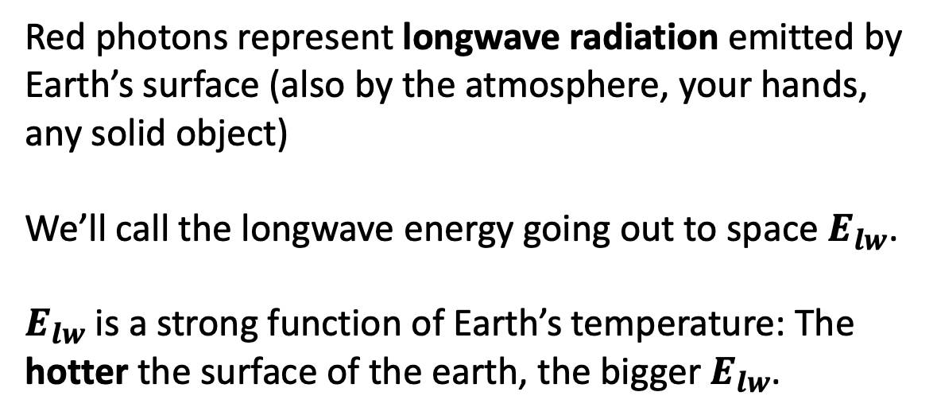
About that PhET simulator: Principle of radiative balance
Red photons represent longwave radiation emitted by Earth’s surface (also by the atmosphere, your hands, any solid object)
We’ll call the longwave energy going out to space $E_{lw}$.
$E_{lw}$ is a strong function of Earth’s temperature: The hotter the surface of the earth, the bigger $E_{lw}$.
https://phet.colorado.edu/sims/cheerpj/greenhouse/latest/greenhouse.html?simulation=greenhouse

